Slide 1


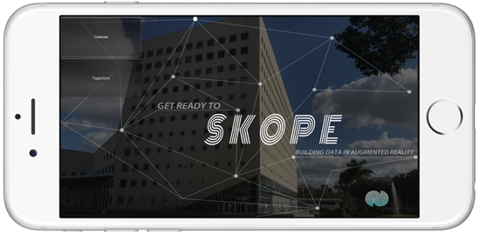
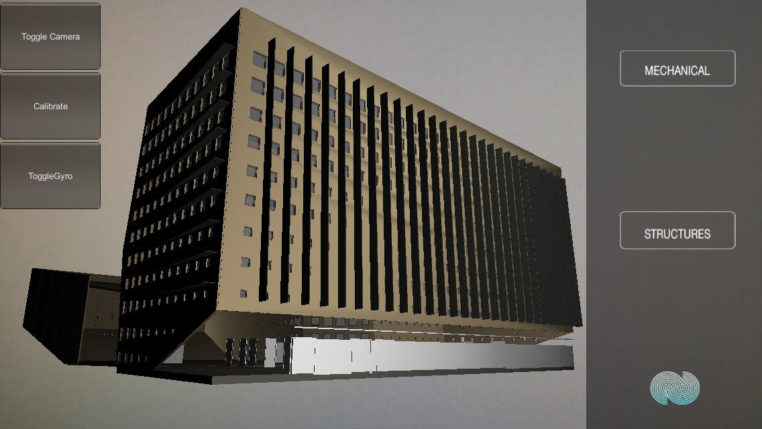
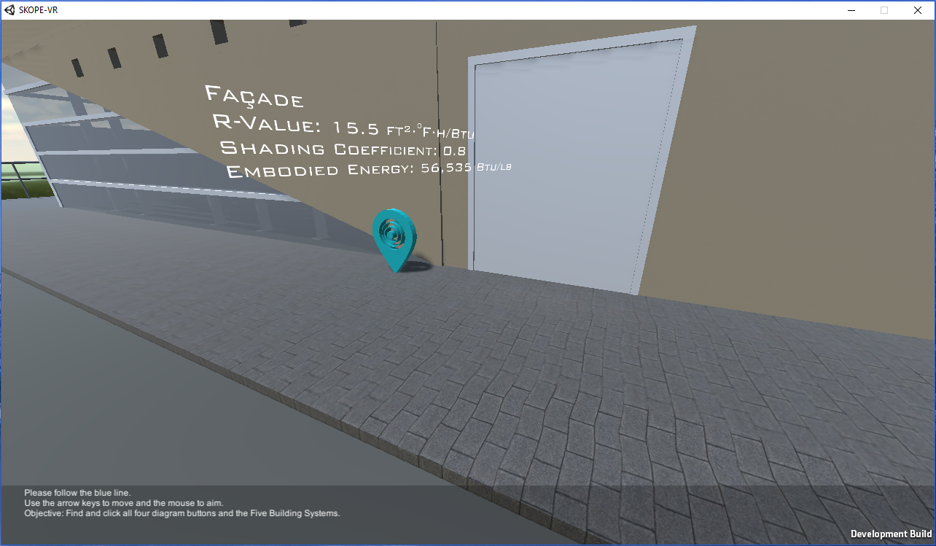
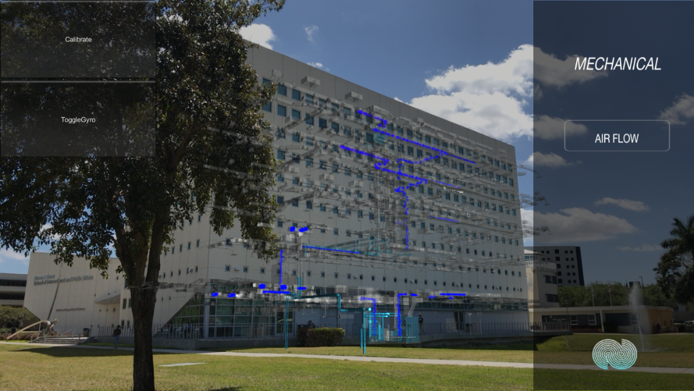
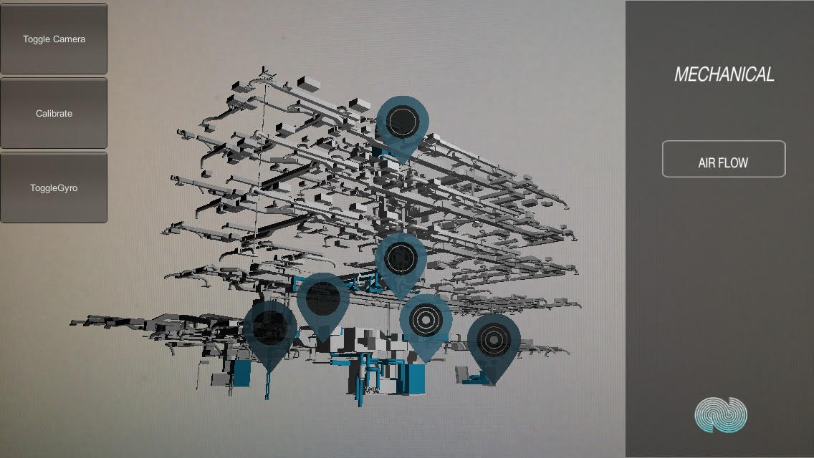
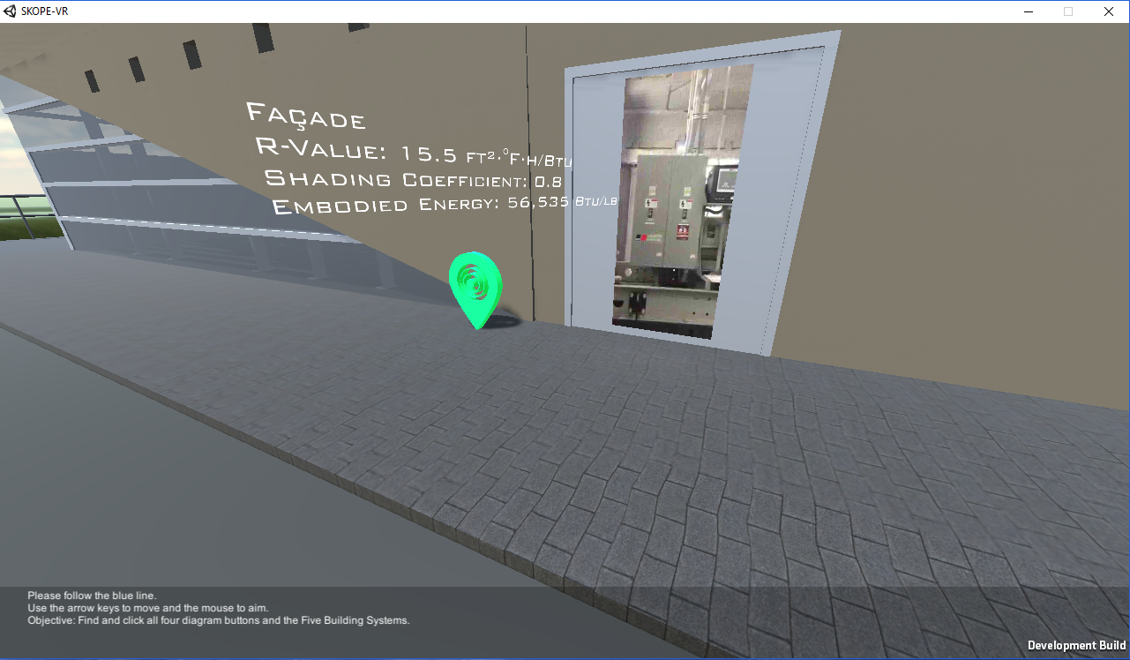





Senior Project, 2017, Spring
Learning With Augmented Reality
Student: Luis Perera, Florida International University
Mentors: Dr. Francisco Ortega, Dr. Shahin Vassigh, Mohsen Taheri
Instructor: Dr. Masoud Sadjadi, Florida International University
Problem
How to implement different behaviors of the application depending on the user interaction?
How to create panel description for the SKOPE-AR application?
How to create an user compliance SKOPE-AR application for iOS deployment?
Solution
A state machine was created to display the available options on certain part of the application.
A text file with all the descriptions was created and loaded by a script and linked to the corresponding panel.
After developing and testing all user stories, a build was created with Unity and released to the AppStore using Xcode.
Requirements
Allow users to pick up a point or position around the building from where they want to start.
Navigate through panels displaying options to select as well as descriptions of the model.
Pause and play recording of the rear camera.
Activate/Deactivate the gyroscope of the device.
Reproduce a video for some parts of the model.
Implement video player in the SKOPE-VR as it is also part of the SKOPE project.
Upload the application to the App Store.
Screenshots
Implementation
Current System
When the user interacts with the application he/she has the following options implemented in this project:
Toggle Camera or Gyroscope: Stop/Play the image capturing or the gyroscope of the device.
Movie Player: Users can now select some parts of the model in order to play an explanatory video.
Panel Navigation: A set of panels and buttons where implemented to facilitate user navigation.
Panel Description: It allows users to see the description of some parts of the model
App Store: The application was uploaded to the App Store and can be now downloaded.
System Design
The system uses a three-tier architecture.
Presentation Tier: iOS/Android applications.
Application Tier: Unity GameObject containing all the Scripts that control the application.
Data Tier: Text file that contains the description for each panel.
Implementation Framework
Graphic Modeling
Deployment
Object Design
Summary
SKOPE-AR provides a model with information of the SIPA building in order to help the Architecture Department to teach core building science concepts. The application enhances learning by showing descriptions and videos of specific design and construction aspects of the model. The latest version of SKOPE-AR is already available for iOS devices on the App Store.
Verification
The application is still in development process and some of the user stories where tested using:
Unit Testing
Rainy Day Test
Sunny Day Test
Acknowledgement
The material presented in this poster is based upon the work supported by Luis Perera. I am thankful to the help that I received from my family, my group member Jeffrey Perez, my mentors, instructors, and the amazing SKOPE team (Albert Elias, Hadi Alhaffar, and Gio Gallardo).
Notes:
1

